Slide 1
CSE 438:
Data Communication & Network
Creating a Network in CISCO Packet Tracer

Slide 2
Team Members & Contributions
We are Team 10 from CSE 438 Section: 3
Zihan Rashid - 1731181042 | Configuring network of Router 2, Computer & IT department
Shadman Sakib - 2014310042 | Configuring network of Router 1, Principle Room & ‘Other’ Category
Md. Mahfujur Rahman - 2021177042 | Configuring network of Router 0, Internet lab & Server room.
NSU | Summer 2023 | CSE 438 | SAM3

Slide 3
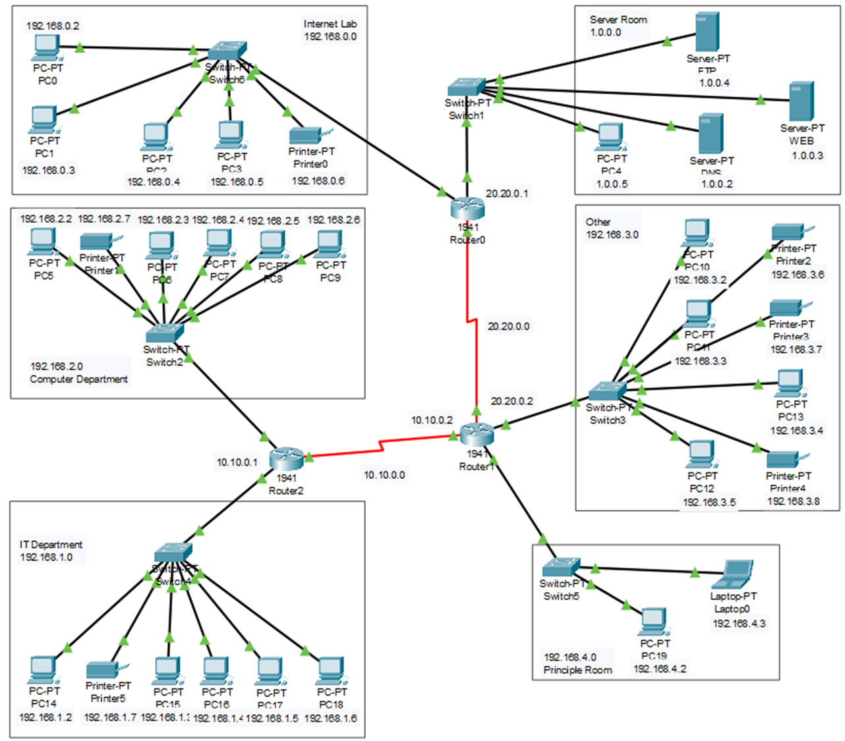
CISCO Network Diagram

Slide 4
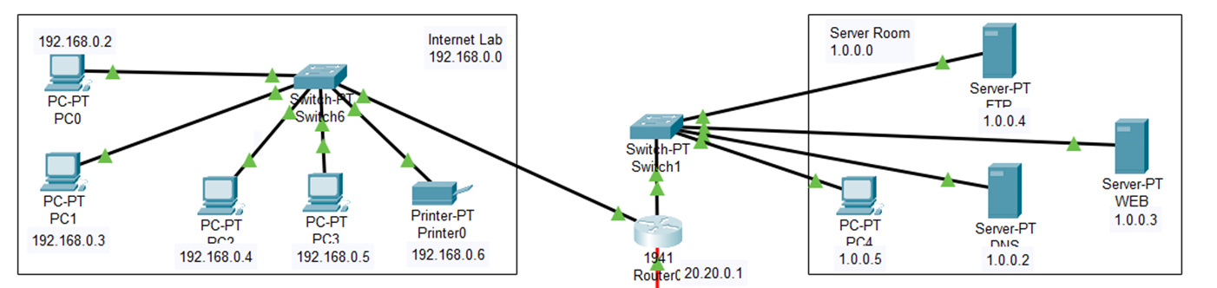
Md. Mahfujur Rahman
Network IP address 192.168.0.0 & 1.0.0.0
IP address, default gateway
Connection among PC, switch, printer, and router
FTP, WEB, DNS server

Slide 5
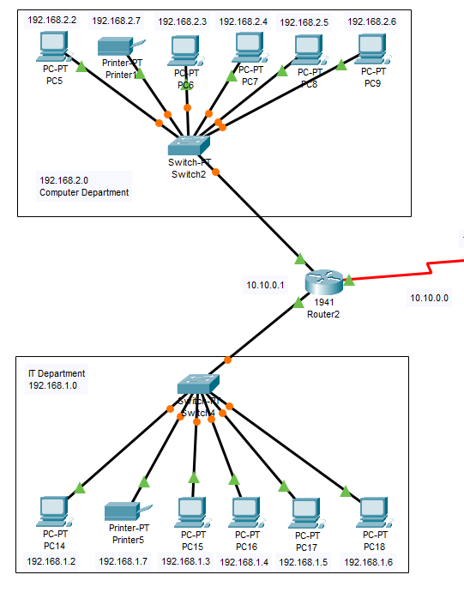
Zihan Rashid
• The Computer Department connected with devices such as PC-PT and Printer-PT having IP addresses in the range 192.168.2.2 to 192.168.2.7, connected through Switch-PT(Switch2).
• The IT Department with devices such as PC-PT (PC14-PC18) with IP addresses ranging from 192.168.1.2 to 192.168.1.6, and an IT printer (Printer 5) at 192.168.1.7, all interconnected via Switch-PT(Switch4).
• Switch4 and Switch2 acts as the bridge linking the IT Department's subnetwork and Computer Department's subnetwork, facilitating seamless communication between IT staff and the Computer Department.
• Both subnetworks, Computer Department at 192.168.2.0 and IT Department at 192.168.1.0, are connected to Router-2, a device that connects them to the Internet. Router-2 ensures smooth data exchange between departments by routing traffic between Switch-PT (Switch2) and Switch-PT (Switch4) that is between Computer Department and IT department

Slide 6
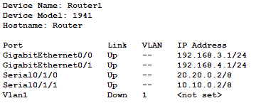
Shadman Sakib
Router-1 is a gateway router that facilitates communication between four sub-networks.
When a device on one sub-network wants to communicate with a device on another sub-network, traffic is directed to Router 1.
Router 1 forwards the traffic to the appropriate destination.

Slide 7


Thank You

